Slide 1
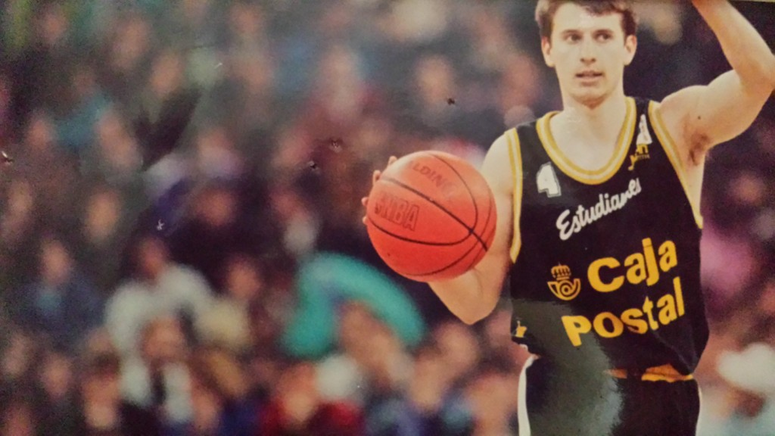
The Sports Mgmt Club is proud to invite you to:
Sports, Education & Entrepreneurship
Pablo Martínez-Arroyo
31-oct 18:30 room 201 (MM31)
Save the date!
King’s Cup champion 1991
Founder of Baloncesto Colegial
Partner at IEP

Slide 2
GREAT EVENT 31/10 @IE Sports Management
@Pablo Martinez Arroyo will be visting us and talking about Sports, Education and Entrepreneurship. Pablo is a former European Basketball Champion who continued his career linking sports with education.
@IE Networking xxxxx
@Miguel Ors Bravo @Joeri Peters @Francisco Roldan @Eduardo Fernandez Cantelli @Lorena Merino Malpica

