Slide 1
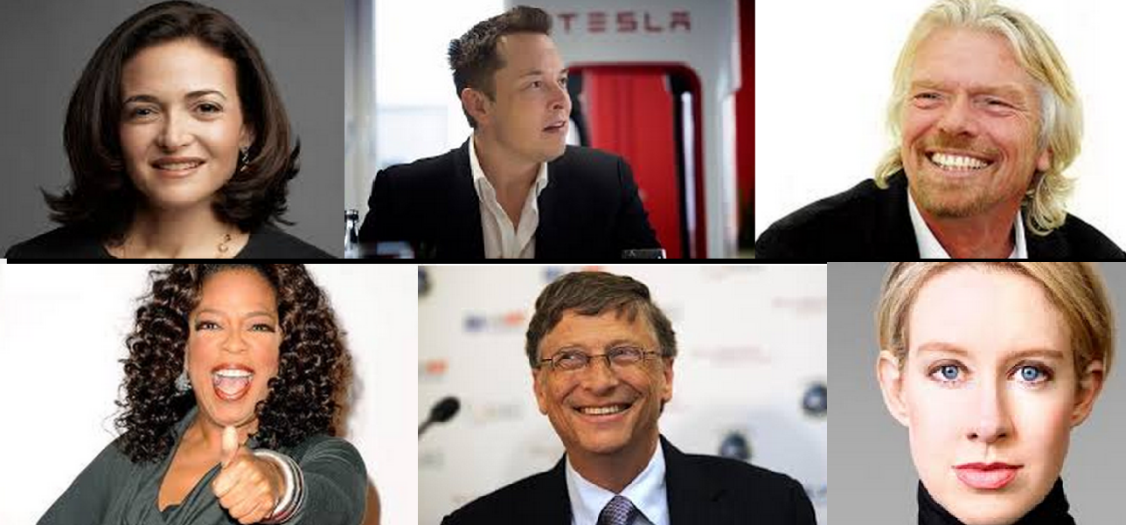
WHAT’S YOURS?
@donasarkar

Slide 2
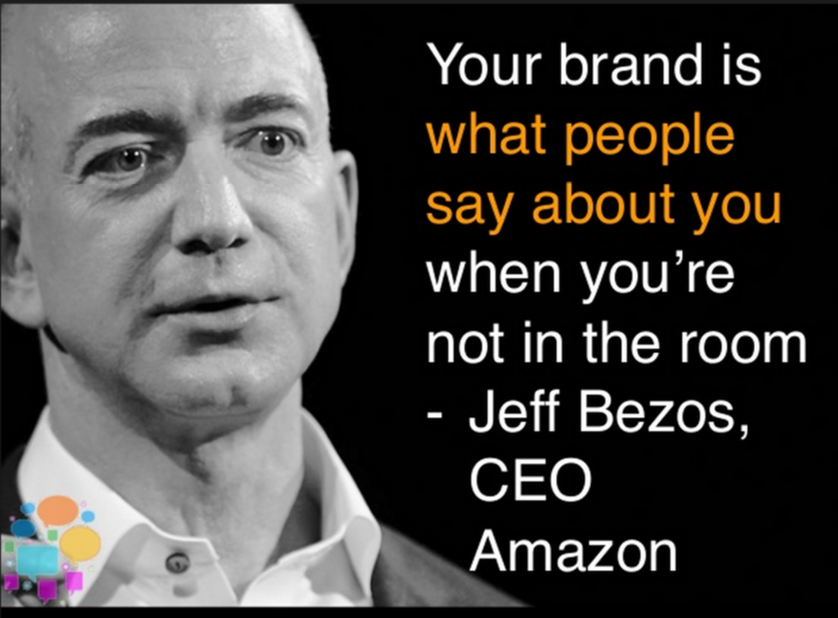
good news: you decide what that is

Slide 3
brand = superpowers + professional presence + reputation + relationships

Slide 4
superpowers = EQ superpower + IQ superpower

Slide 5
EQ superpower
…what have you always done well?
…what do people call on you for?
…this is a skill you will always have
haggling and negotiating or
thinking through details or
organizing lots of people or
writing well or…
data analytics or
operations or
ads or
coding or…
…what class you did love?
…what is your area of study?
…this will change every few years
IQ superpower

Slide 6
EQ superpower = inspiring people to do more than they imagined IQ superpower = being a developer; understanding old school industries like autos, fashion and publishing put ‘em together = building a platform so developers in ALL industries have the most amazing experience possible building apps for hololens

Slide 7
take a minute: what’s yours? tell your own story connect with other similar immerse yourself in your expertise speak about it: conferences, events, skillshare/skillfeed/udemy write about it: articles, blogs, books join: associations related to it curate: best ideas around the issues amplify: ideas of others gain followers

Slide 8
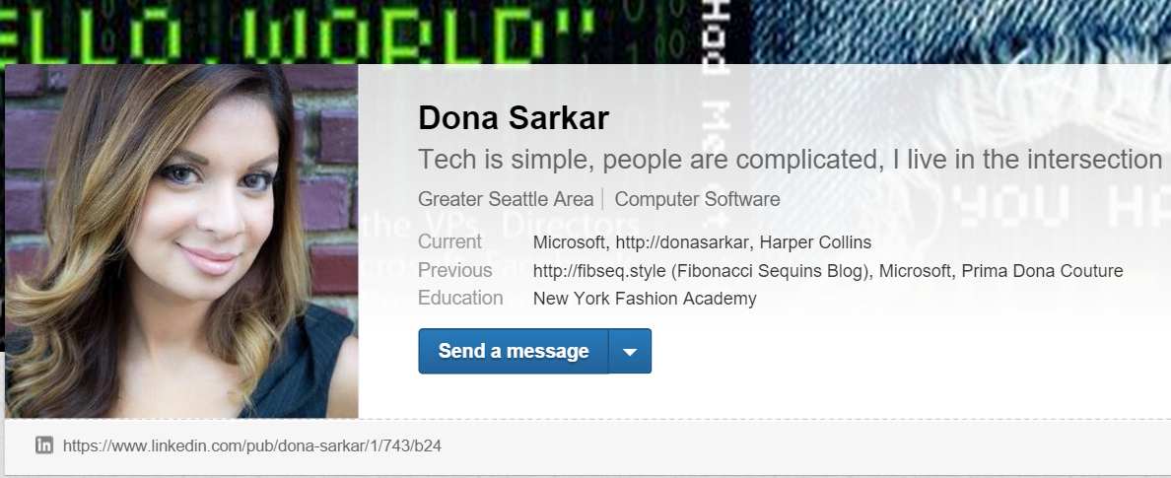
professional presence = IRL + online

Slide 9
in real life: how you dress (one step above) how you stand (hands at sides) how you introduce yourself (first + last name) how your shake hands (firmly) how you sit (elbows away from the body) how you make eye contact (consistent but not creepy) how you sound (6-7 out of 10) how you think (BIG and positive)

Slide 10
OR

Slide 11
aim high(er) bigger prizes have less competition all about the connections

Slide 12
you MUST have a presence if you are not on social media somewhere, you do not exist what is your platform? who do you engage with? what does your headshot look like? what do you share on each channel? online:

Slide 13
your reputation = the questions you ask + the things you make/do + how you do it

Slide 14
attend every meeting you’re invited to put your phone down understand rituals and go along talk 1:1 with people ask the questions (why. who. what. how) track top issues volunteer to fill a gap send around articles about products bring all the enthusiasm

Slide 15
just do. don’t ask for permission rules are someone else’s opinion

Slide 16
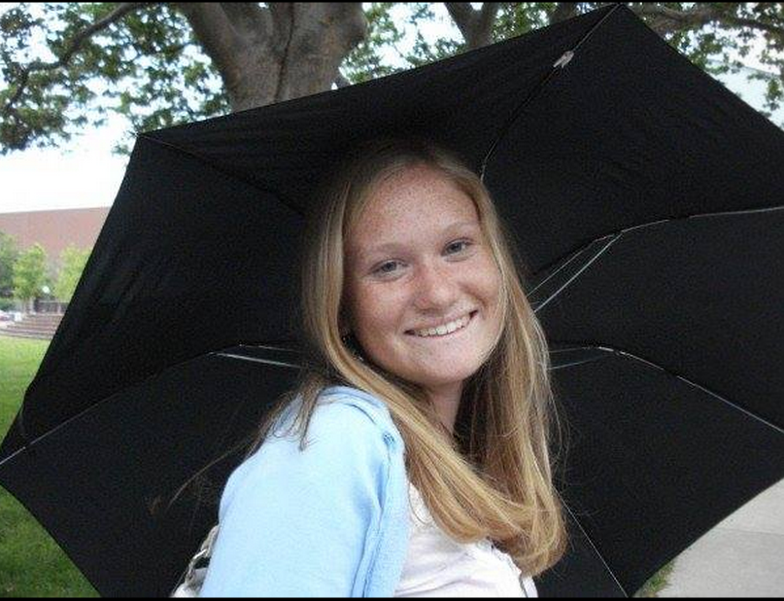
Sarah Ferraro

Slide 17
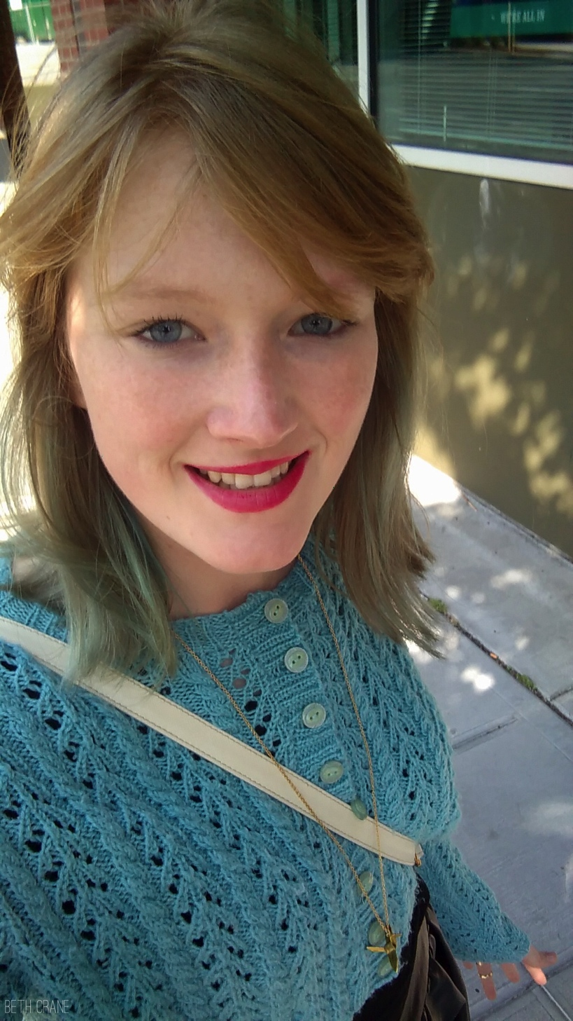
Beth Crane

Slide 18
imposter syndrome it’s a legit thing

Slide 19
fake it till you make it?

Slide 20
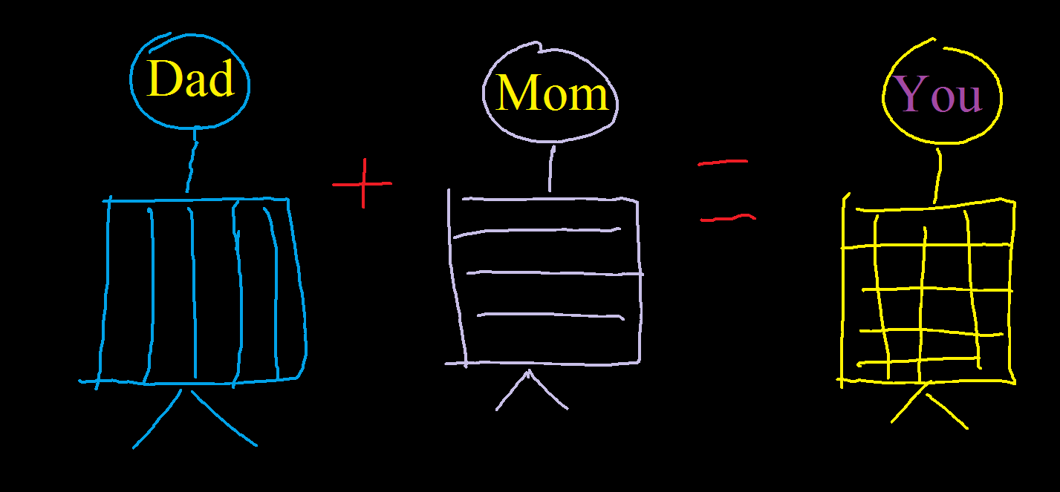
we are all replicas

Slide 21
…so be a replica on purpose…of many people how did you learn to paint. play. sing identify role models who are not imposters find out what they did mimic their work. code. bugs. papers. don’t avoid failure

Slide 22
your relationships = irl + digital + you are the average of the 5 people you interact with the most

Slide 23
attend things. meetings. lectures. meet-ups
thank the speaker or participants (no one hears this enough)
ask for 15 minutes
schedule it
ask “who else”
thank them
volunteer to help them
follow up with what you did
track it
stalk people on medium or twitter. get introduced

Slide 25
Hi Michael: I’m the fashion designer in the front row who stalks you online ☺ Thank you for a truly inspirational talk today. It’s rare after 10 years of being at MS to hear something completely new. I love the idea of drawing being used to unlock creativity and the mind working in a different way. I love your charter of driving Microsoft to be a design focused company. I think that if PepsiCo can do it, we can too! https://hbr.org/2015/09/how-indra-nooyi-turned-design-thinking-into-strategy I have some ideas on how we can bring creativity to the forefront of everyone’s jobs on my team but I’d love your opinion. Do you mind if I set up 15 mins to talk to you about it? Thank you again, Dona

Slide 26
be memorable

Slide 27
you will not stand out if you try to blend in

Slide 28
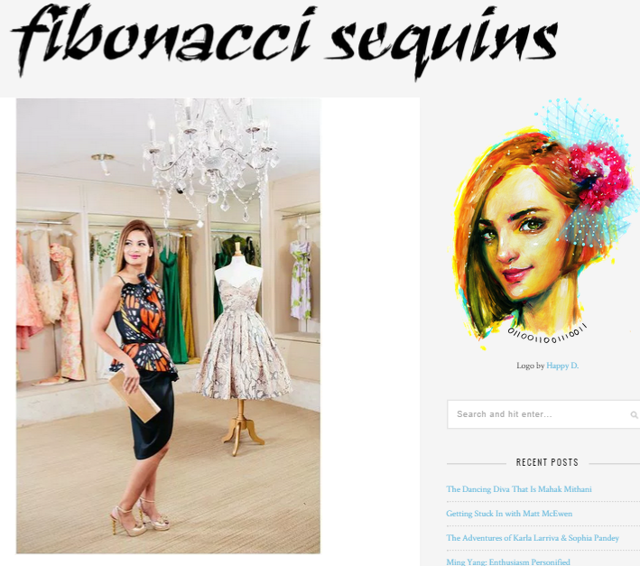
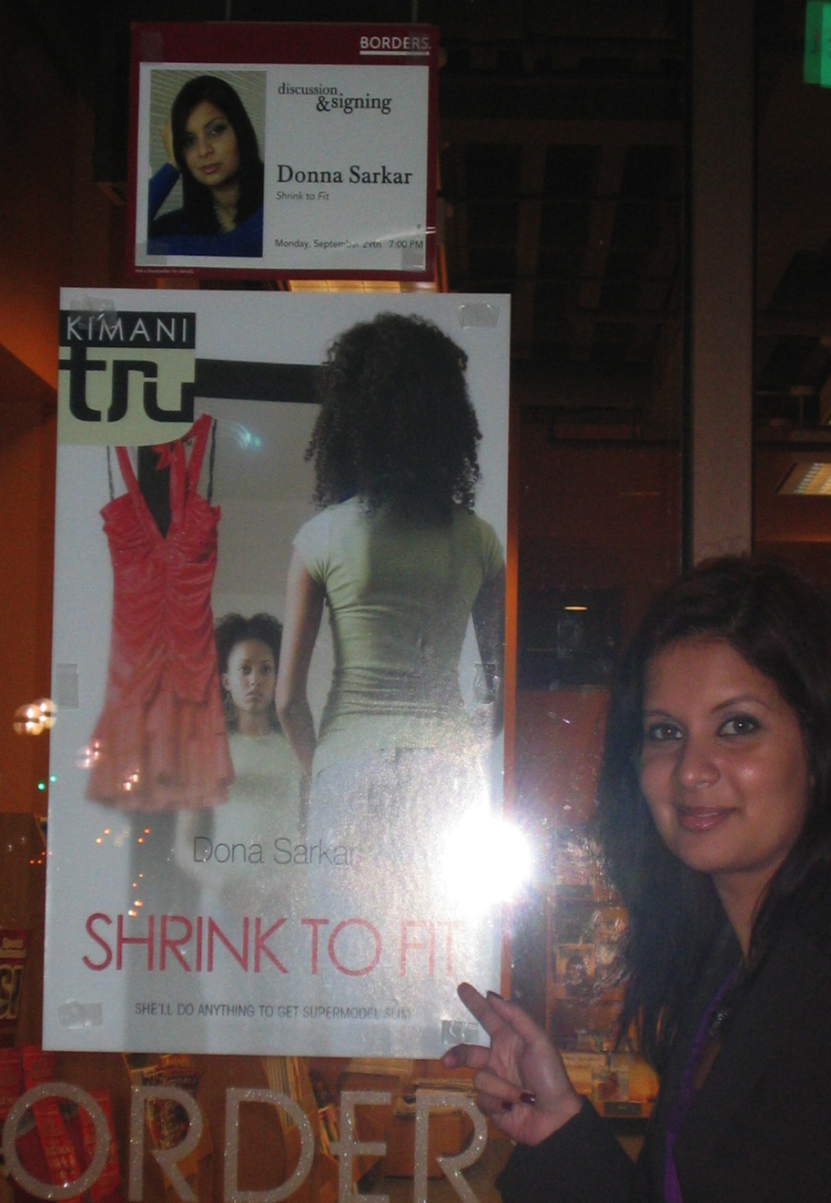

Slide 29
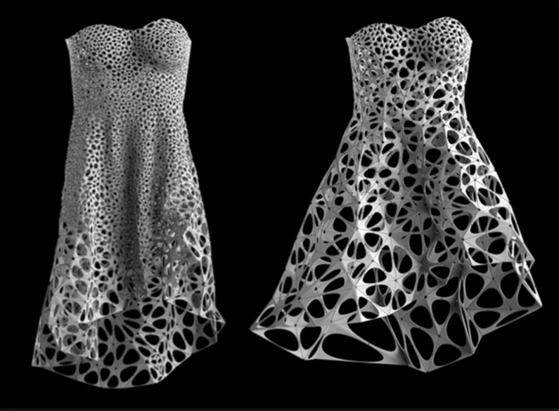
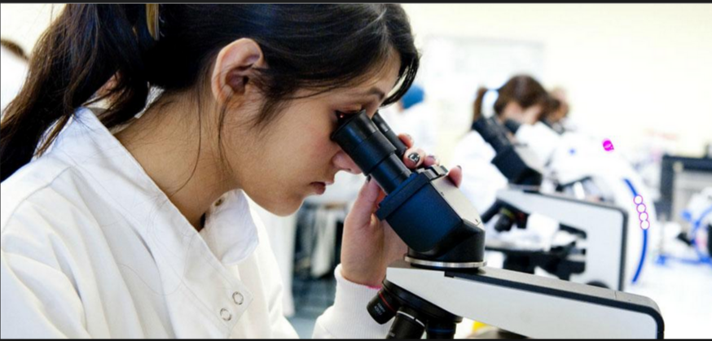
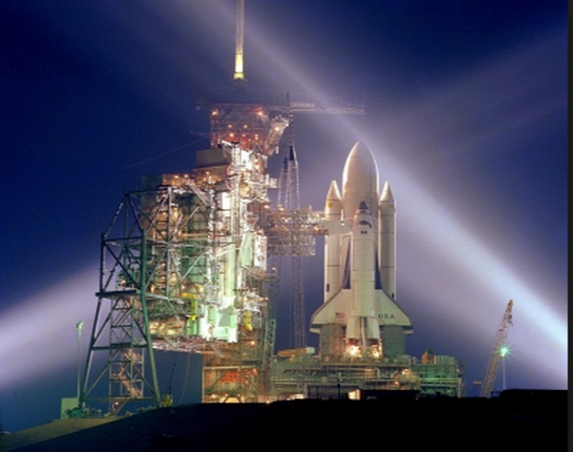
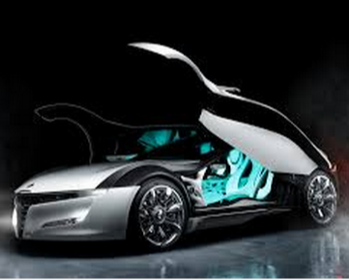

Slide 30
tech = literacy

Slide 31
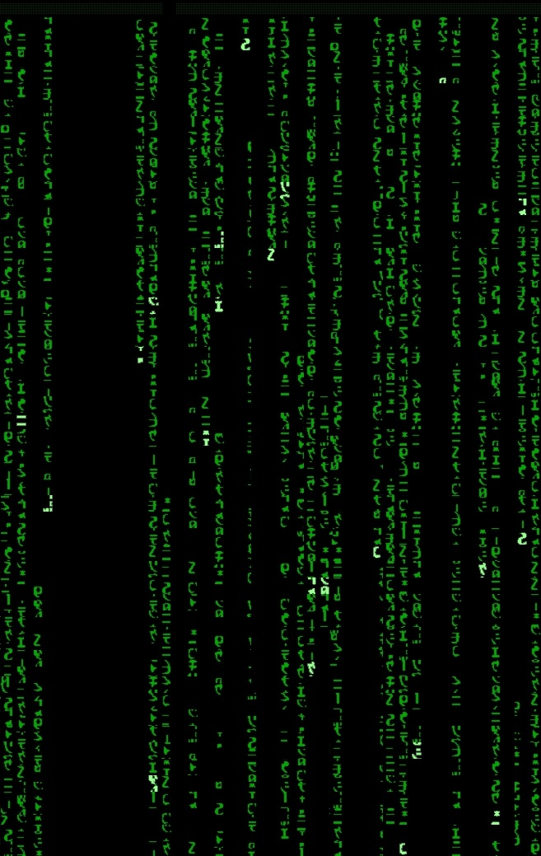
concept of “writing”
we learn to write when we’re young
we use it every day
not all of us work at a publishing company
not all of us are authors
Many of us write without having an english degree
yet this is something that is prevalent in every industry

Slide 32
tech is not different
we use tech every day
not all of us are “coders”
hundreds of jobs that involve tech in other industries
write code
break code
talk to customers
design product vision
manage product lifecycles
run experiments
advocate for customers
develop marketing plans
sell to customers
tech will be a component of every industry’s evolution

Slide 33
not everyone who is a leader at a tech company is a “coder”
Kevin Systrom, Instagram CEO is a marketer
Stewart Butterfield, Slack CEO is a philosophy major
Kieran Snyder, Textio CEO is a linguistics PHD
those “other skills” help you solve problems for humans rather than getting buried in “cool” tech details

Slide 34
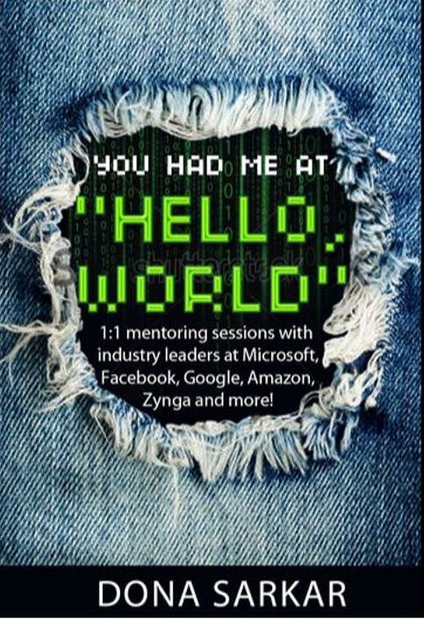
@donasarkar

Slide 35
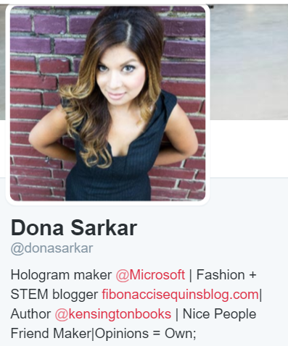
donasa@microsoft.com
twitter.com/donasarkar
facebook.com/donasarkarbooks
instagram.com/donasarkar
linkedin.com/donasarkar

